Slide 1
Human Computer Interaction
THE COMPUTER PART III
positioning, pointing & drawing
touch screen
Tablets
Stylus and Light pen
eye gaze etc
(Input devices)
CS 8th Semester

Slide 2
Positioning, Pointing And Drawing Continued
Some other Devices are:
Touch Screen
Stylus and Light pen
Tablets
Eye Gaze
Discrete Positioning Control
Cursor keys

Slide 3
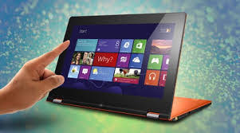
Touch-sensitive screen
Detect the presence of finger or stylus on the screen.
works by interrupting matrix of light beams, capacitance changes or ultrasonic reflections
direct pointing device
Advantages:
fast, and requires no specialised pointer
good for menu selection
suitable for use in hostile environment: clean and safe from damage.
Disadvantages:
finger can mark screen
imprecise (finger is a fairly blunt instrument!)
difficult to select small regions or perform accurate drawing
lifting arm can be tiring

Slide 4
Touch-sensitive screens (touchscreens)
Touchscreens are another method of allowing the user to point and select objects on the screen, but they are much more direct than the mouse, as they detect the presence of the user’s finger, or a stylus, on the screen itself.
They work in one of a number of different ways:
by the finger (or stylus/small pointed device) interrupting a matrix of light beams,
or by capacitance changes on a grid overlaying the screen,
or by ultrasonic reflections.
Because the user indicates exactly which item is required by pointing to it, no mapping is required and therefore this is a direct device.
The touchscreen is very fast, and requires no specialized pointing device. It is especially good for selecting items from menus displayed on the screen.
Because the screen acts as an input device as well as an output device, there is no separate hardware to become damaged or destroyed by dirt; this makes touchscreens suitable for use in hostile/unfriendly environments.
They are also relatively natural to use and have been used successfully as an interface to information systems for the general public.

Slide 5
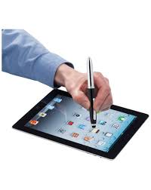
Stylus and light pen
Stylus
small pen-like pointer to draw directly on screen
may use touch sensitive surface or magnetic detection
used in PDA, tablets PCs and drawing tables
Light Pen
now rarely used
uses light from screen to detect location
BOTH …
very direct and obvious to use
but can obscure screen

Slide 6
Stylus and Light pen
Stylus: For more accurate positioning (and to avoid greasy screens), systems with touch sensitive surfaces often employ a stylus.
Instead of pointing at the screen directly a small pen-like plastic stick is used to point and draw on the screen.
This is particularly popular in PDAs, but they are also being used in some laptop computers.
light pen: An older technology that is used in the same way is the light pen.
The pen is connected to the screen by a cable and, in operation, is held to the screen and detects a burst of light from the screen phosphor during the display scan.
The light pen can therefore address individual pixels and so is much more accurate than the Touchscreen.

Slide 7
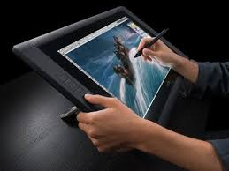
Digitizing tablet
Mouse like-device with cross hairs
used on special surface - rather like stylus
very accurate - used for digitizing maps

Slide 8
Digitized Tablet
The digitizing tablet is a more specialized device typically used for freehand drawing, but may also be used as a mouse substitute.
Some highly accurate tablets, usually using a puck (a mouse-like device), are used in special applications such as digitizing information for maps.
The tablet provides positional information by measuring the position of some device on a special pad, or tablet, and can work in a number of ways.

Slide 9
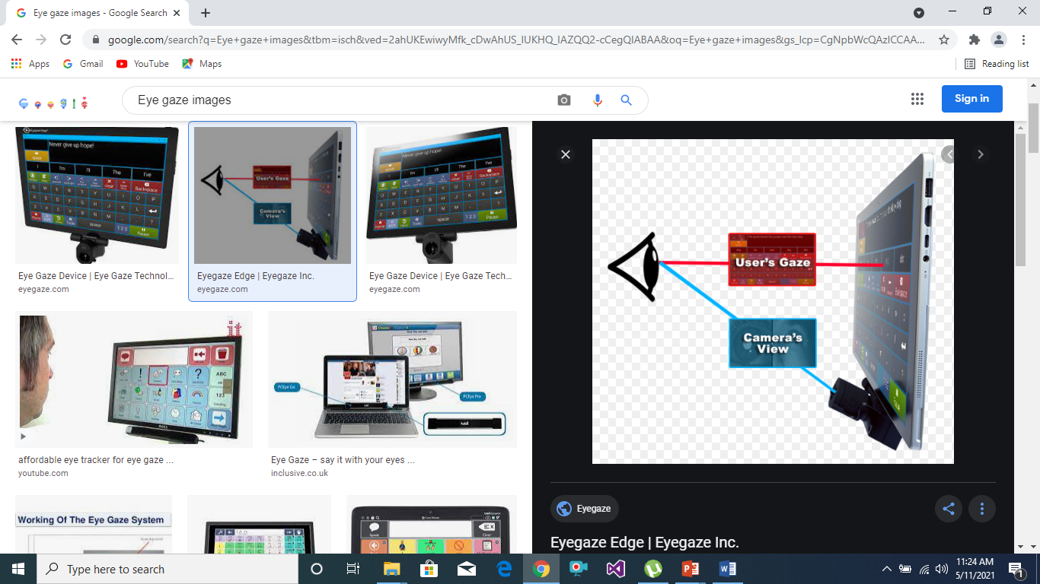
Eye Gaze

Slide 10
Eye gaze
control interface by eye gaze direction
e.g. look at a menu item to select it
uses laser beam reflected off retina
… a very low power laser!
mainly used for evaluation (ch x)
potential for hands-free control
high accuracy requires headset
cheaper and lower accuracy devices available sit under the screen like a small webcam

Slide 11
Eye Gaze
Eye gaze systems allow you to control the computer by simply looking at it! Some systems require you to wear special glasses or a small head-mounted box, others are built into the screen or sit as a small box below the screen.
A low-power laser is shone into the eye and is reflected off the retina. The reflection changes as the angle of the eye alters, and by tracking the reflected beam the eye gaze system can determine the direction in which the eye is looking.
The system needs to be calibrated, typically by staring at a series of dots on the screen, but thereafter can be used to move the screen cursor or for other more specialized uses.
Eye gaze is a very fast and accurate device, but the more accurate versions can be expensive.

Slide 12
Cursor keys
Four keys (up, down, left, right) on keyboard.
Very, very cheap, but slow.
Useful for not much more than basic motion for text-editing tasks.
No standardised layout, but inverted “T”, most common

Slide 13
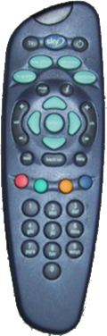
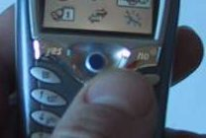
Discrete positioning controls
In phones, TV controls etc.
Cursor pads or mini-joysticks
Discrete left-right, up-down
Mainly for menu selection

